Slide 1
Access & Inclusive Rowing Provision
September 2019

Slide 2
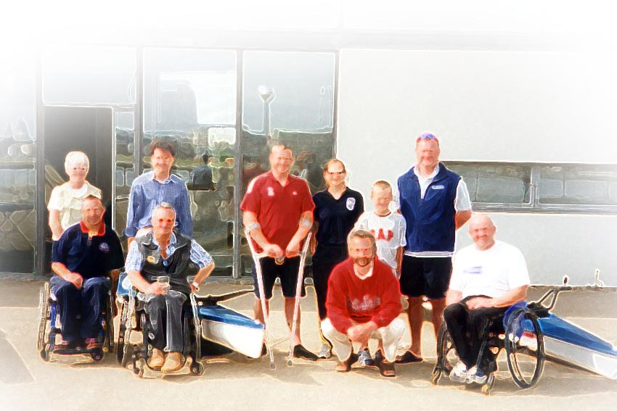
Access through Inclusion

Slide 3
Access through Inclusion
In addressing the potential for including members with a disability in a rowing club, the following broad groups of people have been considered:
Wheelchair users and the ambulant person with a physical impairment
People with a Visual Impairment
People with a Learning Impairment
People with a Hearing Impairment
Notes:
Access to the sport of rowing for people with a disability including opportunities to coach and contribute to the club administration, can be facilitated with the application of some thought and consideration. In addressing the potential for the inclusive provision of rowing, the following broad groups of people have been considered:
Wheelchair users and the ambulant person with a physical impairment
People with a visual impairment
People with a learning impairment
People with a hearing impairment

Slide 4
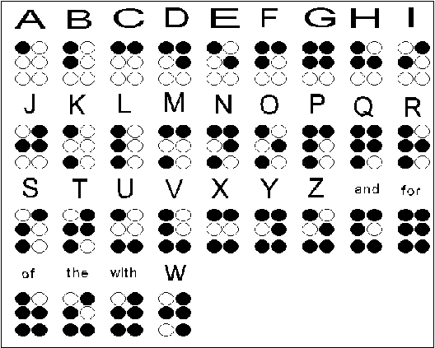
Access is more than Ramps, Doorways, Toilets
Club Committees
Social Engagement
Welcoming Environment
Information in appropriate sensory format
Braille
Large Print
Audio
Notes:
Inclusive participation in the sport of rowing through access will only work if the right attitude exists within the club towards individuals with a disability. This is far more important than any disability awareness or equity training.
Whilst access to participation in rowing can be facilitated by appropriate equipment and coaching practice, of at least equal importance is access and mobility around the clubhouse and in the route to the ‘rowing environment’. It is also important to encourage rowers with a disability to join in all the club activities including social and committee structures.
Access is more than providing ramps and having doorways with sufficient width for wheelchairs. Access can mean many things including, access to information in the appropriate sensory format, access to a socially welcoming environment. The needs of people with mobility difficulties, but not necessarily wheelchair users, people with a visual impairment, those with a hearing impairment, and individuals with a learning disability all need to be accommodated.
In providing an accessible resource for people with a disability, a club will often give improved access to other groups in the community such as the young or elderly, and those with temporary ‘special needs’ such as parents with pushchairs.
On the whole, we practice rowing in an environment which has been designed and developed by able-bodied people for use by people with a disability. Often it is the features of a situation that create the unnecessary barriers to access. If we consider the lock to the club door, why are so many latch type locks placed at chest level to the average ambulant person, when they would be equally of use at a lower level that would also be accessible to someone in a wheelchair? The aim must be to provide an inclusive environment so that the activities and facilities within the clubhouse provision are is accessible by all club members irrespective of their ability.
The provision of facilities that enable individuals with a disability can be devised so that special features are not glaringly obvious. For example, a clear and well-lit notice board will be seen equally well by people with a visual impairment, as it will by the rest of the club members.
Many modifications and adaptations to existing facilities can be made simply by having a policy that resolves to address the needs of individuals with a disability. In this way changes are considered every time a change or renewal of any facility is reviewed in the usual cycle of repairs and maintenance. Often the renewal or repair of a resource to incorporate inclusive use is no costlier than to restore the facility to its original, but non-accessible function.

Slide 5
Key elements to the delivery of inclusive Rowing Practice
Club Consultation
Equipment adaptations
Upgrades to club, boathouse
Toilet, Shower facilities
Communication
Information boards with appropriate format
Signage
Radio links, Ergchatter
Coaching
Ask individual with a disability to participate in awareness training
Coaching Qualifications
Preparation of coaching resources
Club Administration
Committee members – Chair, Secretary, Treasurer
Safety
Welfare
Notes:
There are four key elements to the delivery of inclusive rowing practice:
Consultation
Communication
Coaching
Club Administration
Coaching – when a club has members with a disability it is important for coaches to have some disability awareness training.
Club Administration – The majority of rowing clubs have an administrative structure managed by its members. Individuals with a disability should be encouraged and enabled to contribute to club administration through its various committees. In this way they can be consulted on all areas of the clubs functioning, be part of the decision-making process, take on responsibilities and generally make a contribution to the club’s organisation.
Depending on the needs of the individual, this will require giving thought to how these committees function so that they can contribute fully. This may mean ensuring that meetings are held in a room that is physically accessible (appropriate to a wheelchair user needs). If the person has a visual impairment this may mean presenting minutes in braille/audiotape. If the person has a hearing impairment, ensure that there is an interpreter who can use appropriate sign language.
If the club has members with a learning disability, consider appointing an enabler, who will help them to understand both the procedures of meetings and the content of an agenda.

Slide 6
Access Audit
The Access audit should include:
Location
Car Parking
Footpaths
Steps
Access to boathouse
Access to water
Sanitary/Shower facilities
Signage and information
Equity
Notes:
Adaptive Access Audit
The following access audit has been developed as a checklist for rowing clubs wishing to open up their facilities to inclusive participation. The audit is to enable users who will include people with physical, sensory and cognitive impairments, which may be progressive, intermittent or permanent.
The accessible rowing club benefits everyone, including wheelchair users, older people and families, particularly those with young children.
The Access audit should include:
Location
Car Parking
Footpaths
Steps
Access to boathouse
Access to water
Sanitary/Shower Facilities
Signage and information
Equity
Audit Strategy
The audit should follow a logical sequential journey following how club members arrive at, enter, move around, use and leave the club starting from the club perimeter, progressing through car parking areas, pedestrian routes, building entrances, reception areas, information, delivery, horizontal and vertical circulation routes, internal spaces, facilities and exits.
The checklist audit should preferably be carried out by a suitably competent individual with access and disability issues relating to rowing.

Slide 7
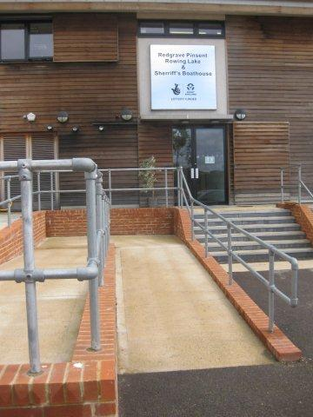
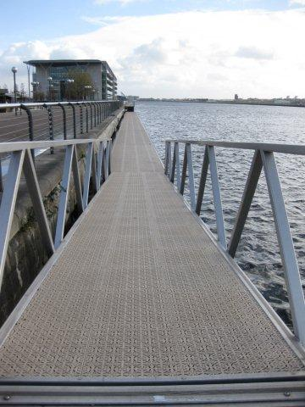
Examples of Accessible Club facilities

Slide 8
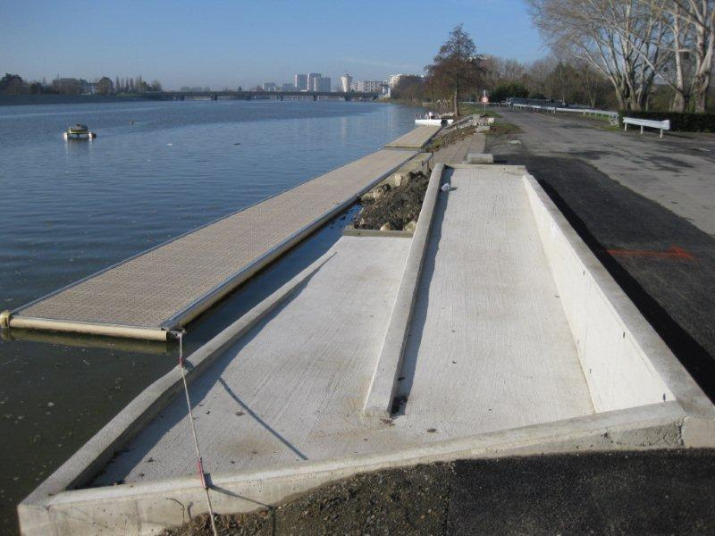
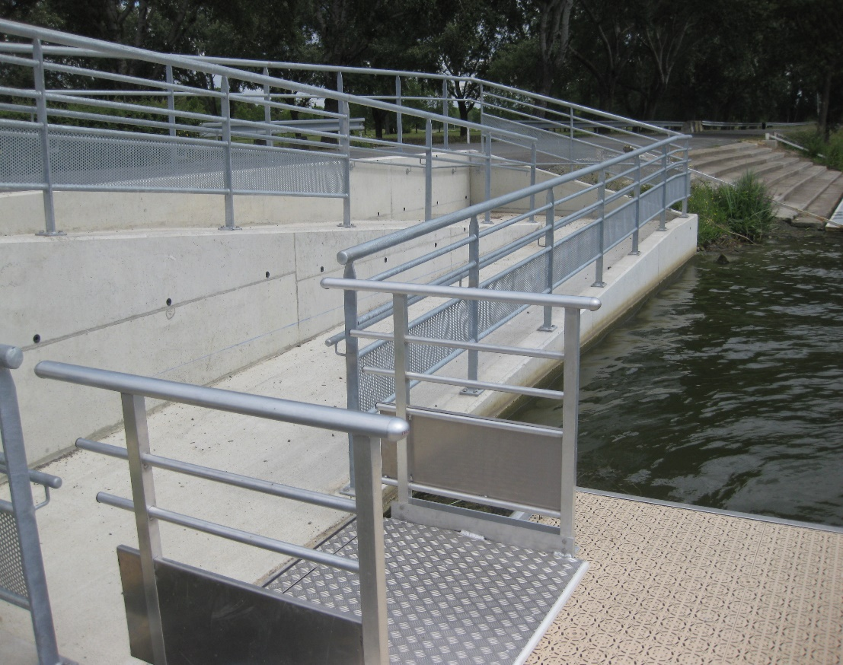
Examples of Accessible Club facilities

Slide 9
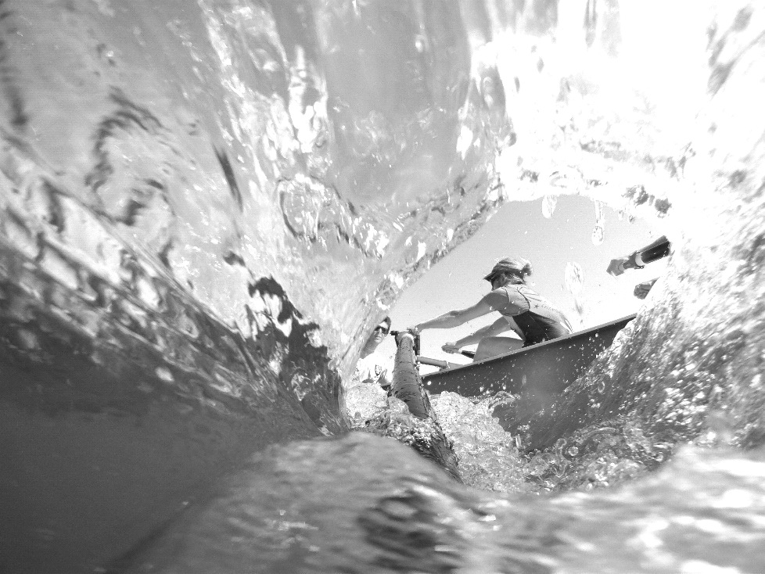
Thank you !
Thank you!

