Slide 1
Para-Rowing Rigging Considerations
September 2019

Slide 2
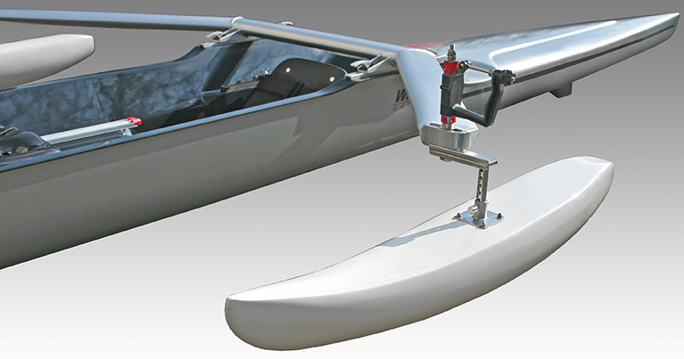

Slide 3
World Rowing Championships – Gifu, Japan, 2005
https://vimeo.com/151682117

Slide 4
PR3
PR3
When considering rigging a boat for PR3 athletes many of the principles that apply to able bodied rigging set-ups will apply.
Further considerations should be given to the following:
Mixed gender crews (strength, height, stroke length)
Disability mix within boat (physical, visual)
Mobility range of athlete (fused ankle, elbow)
Use of prosthetics and the effect of this on stroke length and balance

Slide 5
PR3
The height of the draw
Rower’s movement horizontally with respect to the pin
Notes:
The height of the draw is determined by sitting the athlete in the forward position with just the spoon covered. From here the height of the hands should be between horizontal-level with the shoulder, to below by no more than 6 degrees.
The second adjustment is the rower’s movement horizontally with respect to the pin. The total arc of the stroke comprises approximately 70% of the arc before the pin and 30% after. Therefore, the rower has to be located in a position relative to the pin that enables this balance to be achieved.

Slide 6
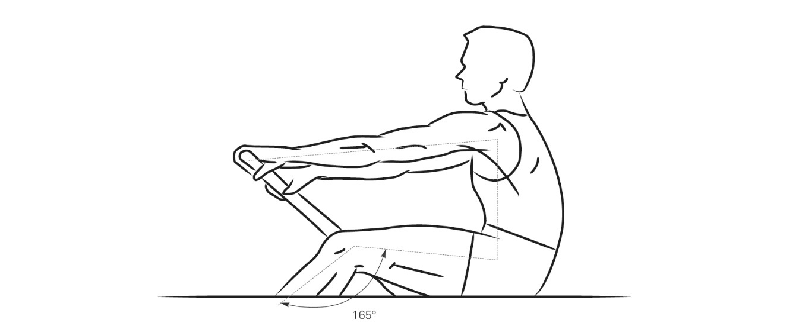
PR3
Body Position at the Orthogonal
Notes:
The stroke length is made up of leg drive body swing and arm draw. When the oar reaches the orthogonal the athlete should be in the following position.
The arms should be straight with the shoulder slightly ahead of the seat. The legs should be slightly bent allowing the 30% of the stroke after the pin to be completed.

Slide 7
PR1 & PR2 (fixed seat boats)
Mixed gender crews (strength, height, stroke length)
Mobility range of athlete
Implications with amputees on balance
Oar/Scull - consider shorter overall length
Reduced inboard length with no ‘cross-over’ in PR1 and no/minimal in PR2 boats
Oarlock heights set level
Factor additional sitting height of athlete with seat padding/cushion
Seat back rake angle set at < 90°
PR2 rowers should be encouraged to maximise their function and row without the backrest if possible
Pontoon depth can impact on rigging heights
PR2 rowers with good sitting balance should be encouraged to row without pontoons
Notes:
PR2 & PR1
Considerations should be given to the following:
Mixed gender crews (strength, height, stroke length)
Mobility range of athlete
Implications with amputees on balance
Oar/Scull - consider shorter overall length
Reduced inboard length with no ‘cross-over’ in PR1 and no/minimal in PR2 boats
Oarlock heights set level
Factor additional sitting height of athlete with seat padding/cushion.
Seat back rake angle set at < 90°
PR2 rowers should be encouraged to maximise their function and row without the backrest if possible
Pontoon depth can impact on rigging heights
PR2 rowers with good sitting balance should be encouraged to row without pontoons

Slide 8
Rigging Overlap PR1/PR2 Boats
PR1 & PR2

Slide 9
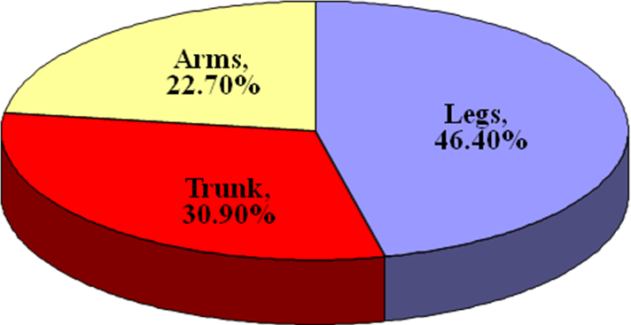
Power
What we can learn from able-body sliding-seat rowing with regards to input of body segments into rowing power?
Legs produce nearly half of rowing power
Trunk produces nearly one third of rowing power
Arms produce nearly one quarter of rowing power
Dr Valery Kleshnev 2006

Slide 10
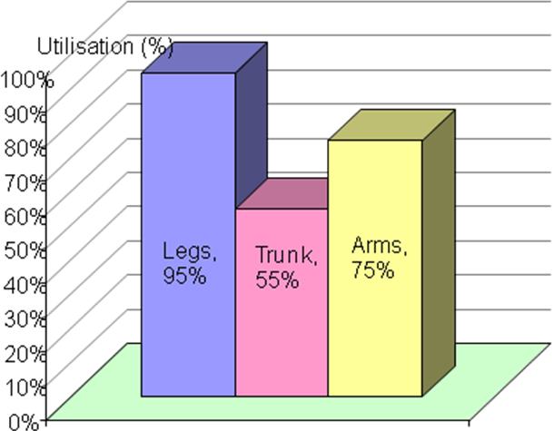
Utilisation
Utilisation of work-capacity of the body segments:
Trunk muscles utilise only about 55% of their power
Legs use up to 95% of their power
Arms’ utilisation is about 75% of their power

Slide 11
Fixed Seat Stroke Arcs
PR1 rower who is strapped to the seat around the torso, the reach is restricted to <600mm, and if the rigging is similar to an able-bodied rower then this results in a stroke arc of around 40 degrees through standard rigging
PR2 rower, the reach is achieved by extending the arms and body swing. The body swing can be exaggerated and a total stroke length of 1000mm can be achieved. On a standard rig this would equate to an arc of 67 degrees
By adjusting the span and the inboard for adaptive athletes, two things can be achieved:
Increased stroke arc overall – aim for >90-degree arc
Distribution of the stroke arc achieved with the optimum position in relation to the pin
Notes:
For an able-bodied rower, the breakdown of the overall stroke length is approximately 50% from the legs 30% from the arms and 20% from the trunk. A typical range of reach for an able-bodied rower is 1500 mm which equates to a stroke arc of around 100 degrees through standard rigging.
For the PR1 rower who is strapped to the seat around the torso, the reach is restricted to <600mm, and if the rigging is similar to an able-bodied rower then this results in a stroke arc of around 40 degrees through standard rigging.
The overall stroke length can be determined using a rowing ergometer, by measuring the distance moved by the handle. Knowing the overall stroke length will enable you to place the athlete in the correct position with respect to the pin so that you can achieve correct ratios of the stroke before and behind the pin.
For the PR2 rower, the reach is achieved by extending the arms and body swing. The body swing can be exaggerated and a total stroke length of 1000mm can be achieved. On a standard rig this would equate to an arc of 67 degrees.
By adjusting the span and the inboard for adaptive athletes, two things can be achieved –
Increased stroke arc overall – aim for >90-degree arc.
Distribution of the stroke arc achieved with the optimum position in relation to the pin @ 55/45 ratio
The following drawing shows some examples with theoretical arcs (including those currently used in adaptive competition) using different rigging configurations for fixed-seat boats, including overall oar length and lever relations together with the different reaches required for each.
There are of course more options for individual adaptations, which will have consequences on power and stroke rate. The widest arc can be extremely effective with long accelerated strokes but needs more power application. The longer reach with shorter inboard needs extensive use of shoulders at the catch but enables a longer release with the handles besides the hips at the finish.
Klauss Filter 2011

Slide 12
Theoretical Stroke Arc Scenarios
Half span | 40º 80 | 60º 80 | 90º 62
Overall length | 278 | 278 | 252
Inboard | 80 | 76 | 58
Overall degree | 40 | 60 | 90
Distribution to work | 50/50 | 55/45 | 55/45
Notes:
The following drawing and table show some examples with theoretical
possible arcs. Using different rigging configurations for fixed-seat boats,
Including overall oar length and lever relations currently used in.
Para-Rowing competition.
There are of course more options for individual adaptations, which will
have consequences on power and stroke rate. The widest arc can be
extremely effective with long accelerated strokes, but needs more
power application. The longer reach with shorter inboard needs
extensive use of shoulders at the catch, but enables a longer release
with the handles besides the hips at the finish.
Klaus Filter 2011

Slide 13
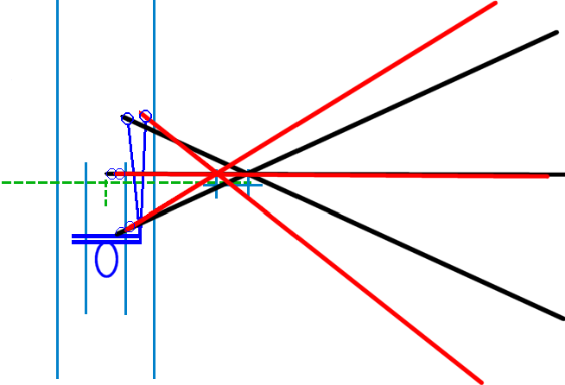
Current trends in Para-Rowing rigging used in international competition

Slide 14
Summary
When evaluating any rigging parameter a clearly defined protocol should be used:
How does it feel?
How does it look?
Record speed measurements / timed pieces
Check / double check
Adjust one parameter at a time only and evaluate
Further consideration:
Encourage a strength and conditioning programme that increases upper thoracic mobility which will allow the athlete to employ effective use of the shoulders, which will help to increase length of the stroke in the fixed-seat boats.
Encourage athletes to feather which will reduce air drag dramatically.
Notes:
Measurements
When evaluating any rigging parameter, a clearly defined protocol should be used –
How does it feel?
How does it look?
Record speed measurements / timed pieces
Check / double check
Adjust one parameter at a time only and evaluate
Further consideration
Encourage a strength and conditioning programme that increases upper thoracic mobility which will allow the athlete to employ effective use of the shoulders, which will help to increase amplitude of the stroke
Encourage athletes to feather which will reduce air drag dramatically.

Slide 15
Para-Rowing Rigging Table
 | Span/Spread (cm) | Inboard | Oar/Scull Length (cm) | Outboard (cm) | Gearing
PR1 beginner | 130-140 | About ½ of span | 230-250 | 160-185 | 2.3-2.7
PR1 | 125-140 | About ½ of span | 240-270 | 170-200 | 2.5-3.2
PR2 beginner | 140-155 | About ½ of span | 245-270 | 165-190 | 2.3-2.5
PR2 | 135-155 | About ½ of span | 260-285 | 180-205 | 2.4-2.8
PR3 (Mix 4+) | 83 – 86 | 113 – 116 | 366-375 | 253-259 | 3.0
A Para-Rowing rigging survey for teams that competed in the Rio Paralympic Games 2016 can be found here: http://www.worldrowing.com/para-rowing/Rigging survey Adaptive Paralympic 2016 POG FINAL
Notes:
The following rigging table is a guide to choosing oars/sculls when deciding rigging for Para-Rowers.
The Outboard measurement, which is simply the total oar length minus inboard, when divided by inboard determines the level of gearing/loading (that is, how heavy the stroke is/feels). For example, if span is 140cm, inboard will be around 70cm. With oars that are 260cm long, outboard = 190cm, so gearing = 190/70 = 2.7 With oars that are 245cm long, outboard = 175cm, so gearing = 175/70 = 2.5
Stronger and more experienced rowers can have higher gearing and beginners and weaker rowers need lower gearing to maximize performance and reduce injury.

Slide 16
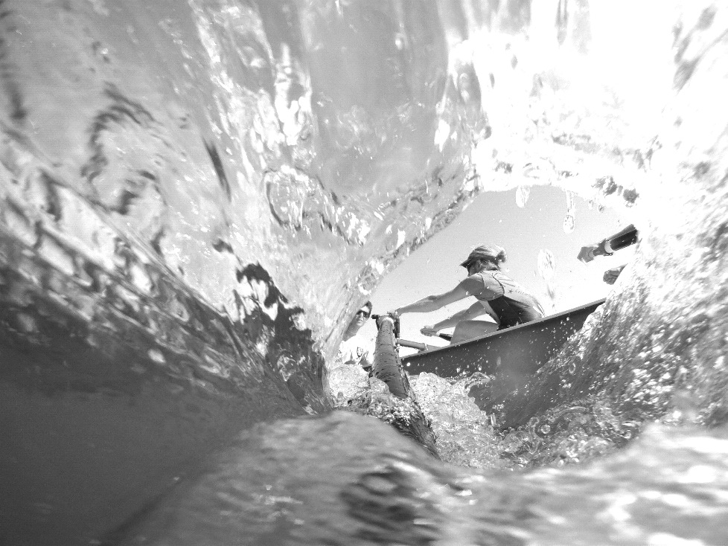
Thank you !
Thank you!

